Slide 1
Neural Architecture Search and Segmentation
Yuncheng Jiang
2020-05-08

Slide 2
CARS: Continuous Evolution for Efficient Neural Architecture Search
Overview
Brief introduction of NAS and Segmentation task
BlendMask: Top-Down Meets Bottom-Up for Instance Segmentation

Slide 3
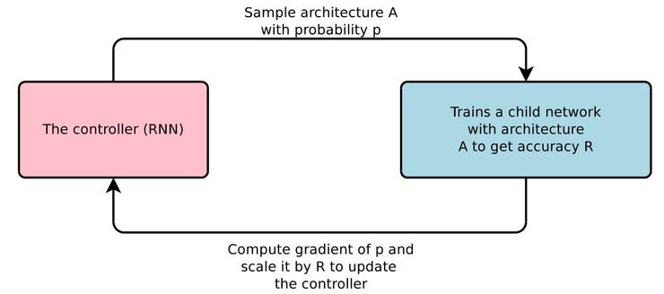
Neural Architecture Search
generate a robust and well-performing neural architecture by selecting and combining different basic components from a predefined search space according to some search strategies
Search space
Search strategy
Evaluation
Cell-based
Entire structure
Hierarchical Structure
··· ···
Gradient descent
Reinforcement learning
Evolutionary Algorithm
Bayesian Optimization ··· ···
Weight sharing
Partial training
··· ···

Slide 4
Neural Architecture Search
No human participation in designing the network structure
Diverse network structure
Very long search time
Huge computing resource consumption

Slide 5
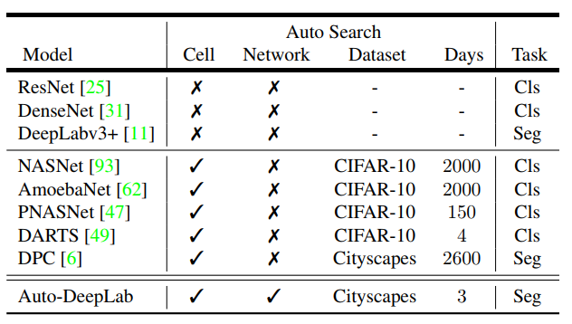
Neural Architecture Search
Auto-DeepLab(2019): Gradient descent-based
Two-level search space and continuous search method

Slide 6
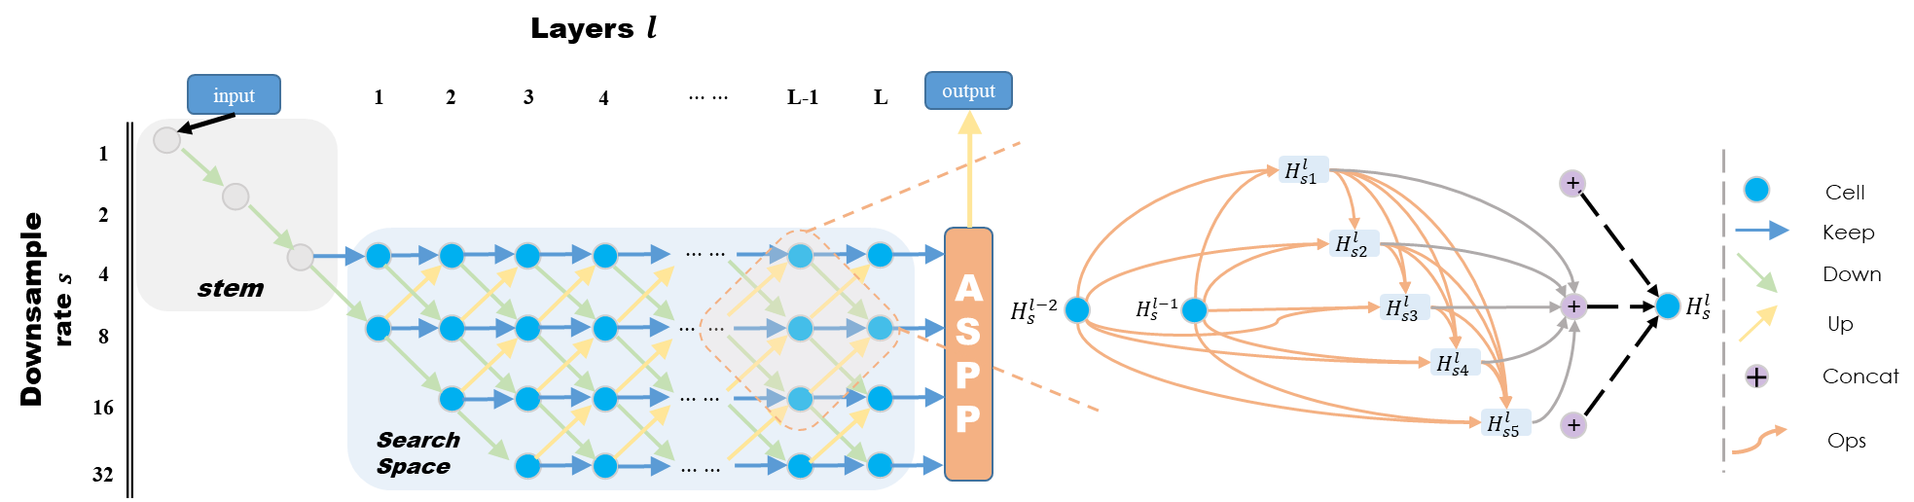

Neural Architecture Search
Cell-Level: $H^{l}=Cell(H^{l−1},H^{l−2};α)$
${\overline{O}}_{j→i}\left(H_{j}^{l}\right)=\sum_{O^{k}∈O}{α_{j→i}^{k}O^{k}(H_{j}^{l})}$
Network-level: ${}_{ }^{s}{H^{l}}=β_{\frac{s}{2}→s}^{l}{Cell}_{down}+β_{s→s}^{l}{Cell}_{keep}+β_{2s→s}^{l}{Cell}_{up}$

Slide 7
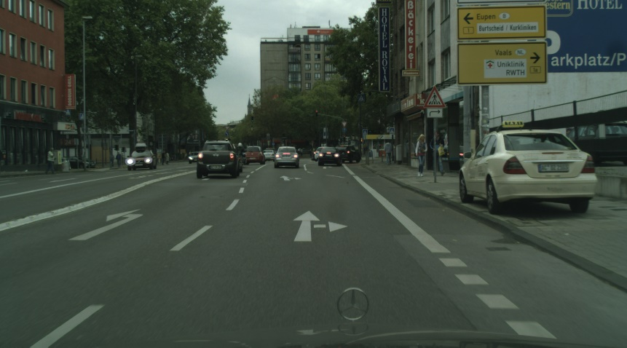
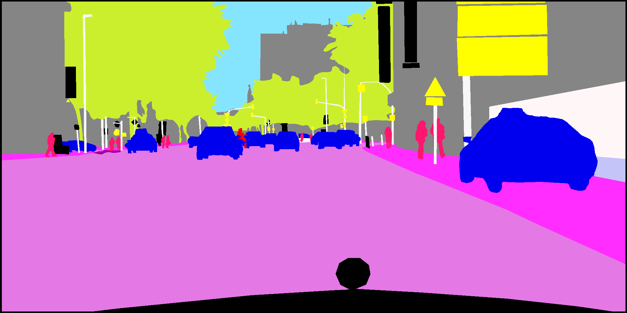

Semantic Segmentation
The task of assigning a semantic label, such as “road”, “car”, “person”, to every pixel in an image
Input: A image $X=\{x_{1},x_{2},…,x_{N}\}$, where $N=W×H$ is total pixel number
Output: Segmentation mask $M=\left\{m_{1},m_{2},…,m_{N}\right\}$ each pixel $m_{i}∈L$, where $L=\left\{l_{1},l_{2},…,l_{k}\right\}$ is label space
Segmentation

Slide 8
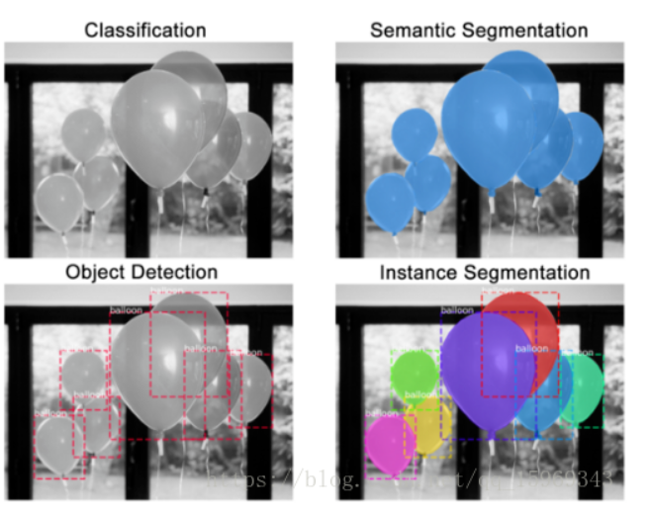
Semantic Segmentation⁺
Visual understanding of the world
From Coarse-grained to Fine-grained
Hardest: instance segmentation
(semantic segmentation + object detection )

Slide 9
CARS: Continuous Evolution for Efficient Neural Architecture Search
Overview
Brief introduction of NAS and Segmentation task
BlendMask: Top-Down Meets Bottom-Up for Instance Segmentation

Slide 10
﻿ CARS: Continuous Evolution for Efficient Neural Architecture Search
﻿ Zhaohui Yang1, Yunhe Wang2, Xinghao Chen2
Key Lab of Machine Perception Huawei Noah’s Ark Lab

Slide 11
CARS - Motivation
the search cost of EA is much expensive due to the evaluation procedure of each individual. We can evaluate on the whole generation.
weight sharing approach of each individuals is inefficient. We can only share the excellent individuals
Most pervious works only evaluate on single objective. But we should consider more objectives to make the model more efficient and robust.

Slide 12



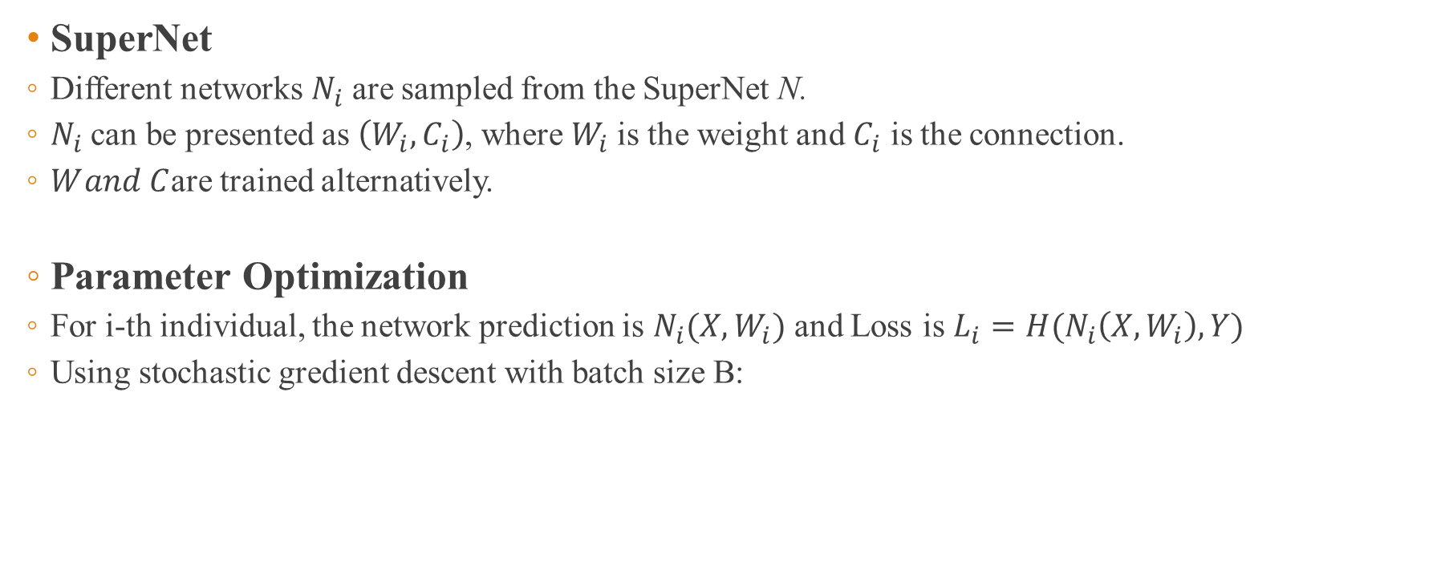
CARS - Approach
SuperNet
Different networks $N_{i}$ are sampled from the SuperNet N.
$N_{i}$ can be presented as $\left(W_{i},C_{i}\right)$, where $W_{i}$is the weight and $C_{i}$ is the connection.
$W_{ }and C$are trained alternatively.
Parameter Optimization
For i-th individual, the network prediction is $N_{i}(X,W_{i})$ and Loss is $L_{i}=H(N_{i}\left(X,W_{i}\right),Y)$
Using stochastic gredient descent with batch size B:

Slide 13
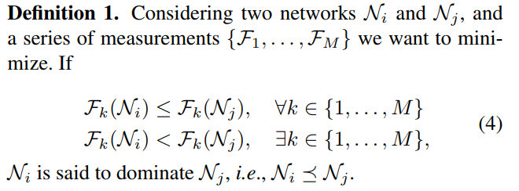

CARS - Approach
Architecture Optimization
non-dominated sorting strategy introduced in the NSGA-III
P different networks: $\{N_{1},N_{2},…,N_{P}\}$ and M different measurements(latency, accuracy, etc.) : $\left\{F_{1},..F_{M}\right\}$
Dominate:
1. 任意一个大于等于
2. 存在一个大于
即至少存在一个更好且其余都不差

Slide 14
CARS - Approach
pNSGA-III: Improvement for small model trap phenomenon
Highlight: Takes the increasing speed of the accuracy into consideration.
Two sorting stage:
Model size
&
Accuracy
U
Top P networks
model size
&
increasing speed of accuracy

Slide 15
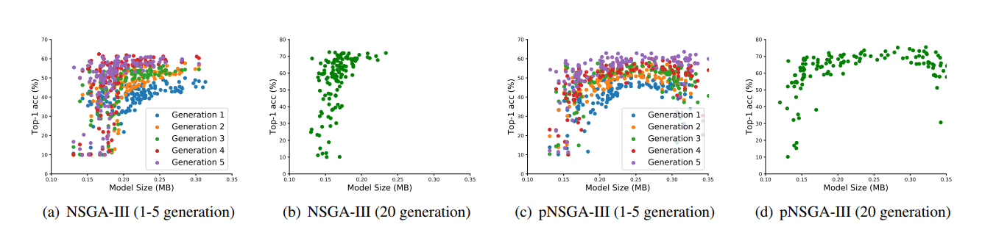
CARS - Approach
pNSGA-III: Improvement for small model trap phenomenon
maintained architectures covers a large range over the model size dimension

Slide 16
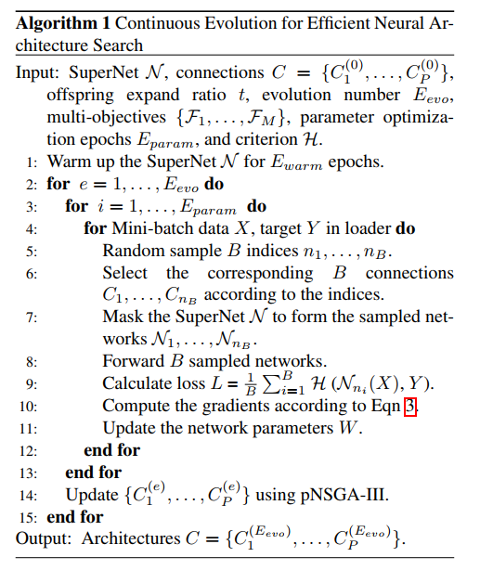
CARS - Approach
Overview of Continuous Evolution
Parameter optimization
Architecture optimization

Slide 17
CARS - Experiment
Experimental Settings
SuperNet Backbones based on DARTS:
searching for normal and reduction cells and stacking them.
Evolution Details Both crossover ratio and mutation ratio are set to 0.25, and we randomly
generate new architectures with a probability of 0.5

Slide 18
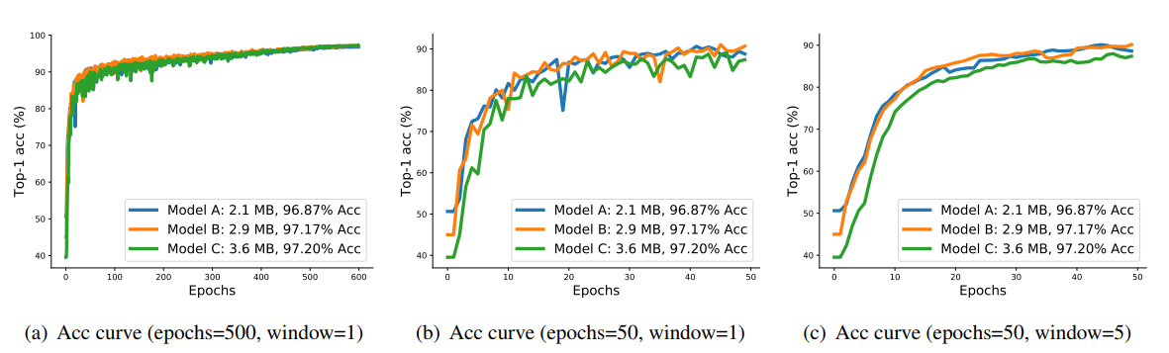
CARS - Experiment
Experiments on CIFAR-10
Small Model Trap

Slide 19
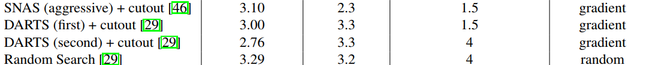
CARS - Experiment
Experiments on CIFAR-10
Search on CIFAR-10: 25000 for parameters and 25000 for architectures; 500 epochs
Retrain on CIFAR-10: training the maintained 128 architectures
Evaluate on CIFAR-10

Slide 20
CARS - Conclusion
It reduced the search time cost for EA method
It maximally utilize the learned knowledges such as architectures and parameters.
It introduced the pNSGA-III method solved the small model trap.

Slide 21
CARS: Continuous Evolution for Efficient Neural Architecture Search
Overview
Brief introduction of NAS and Segmentation task
BlendMask: Top-Down Meets Bottom-Up for Instance Segmentation

Slide 22
﻿ BlendMask: Top-Down Meets Bottom-Up for Instance Segmentation
﻿ Hao Chen₁, Kunyang Sun₂
The University of Adelaide Southeast University

Slide 23
BlendMask - Background
top-down apporach
It uses a sliding window to predict a mask proposal on each spatial area
Problems
local-coherence between features and masks is lost
the feature representation is redundant because a mask is repeatedly encoded at each foreground feature
position information is degraded after downsampling with strided convolutions

Slide 24
BlendMask - Background
bottom-up approach
It generate dense per-pixel embedding features and use some techniques to group them
Problems
heavy reliance on the dense prediction quality, leading to sub-par performance and fragmented/joint masks
limited generalization ability to complex scenes with a large number of classes
requirement for complex postprocessing techniques.

Slide 25
BlendMask - Motivation
One stage segmentation approaches are easier for optimization than two-stage approaches.
We should focus more on one stage approaches.
top-down and bottom-up strategy have their own merits. We can try to merge them together.

Slide 26
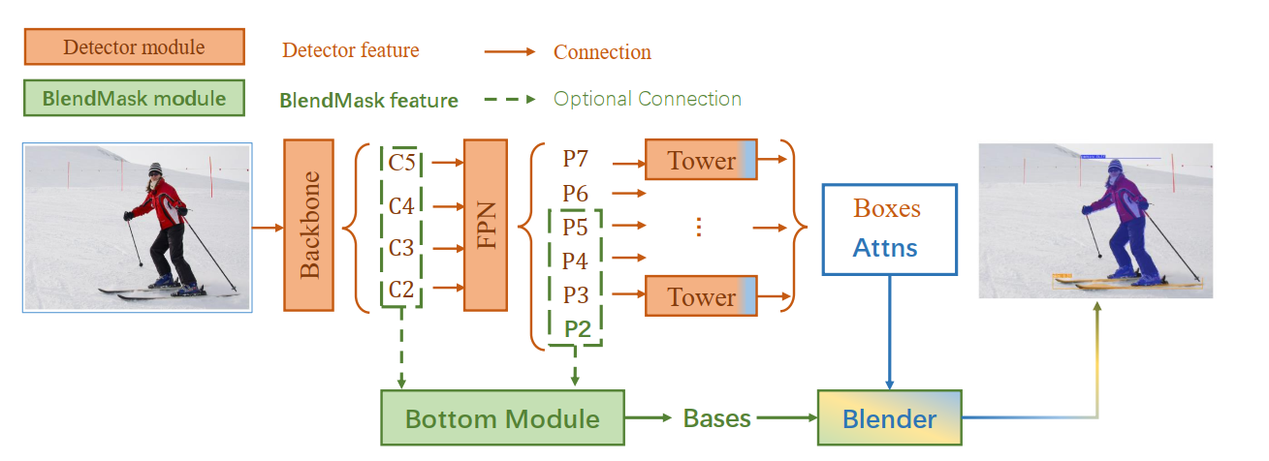
BlendMask - Approach
Overview
1
3
4
2

Slide 27
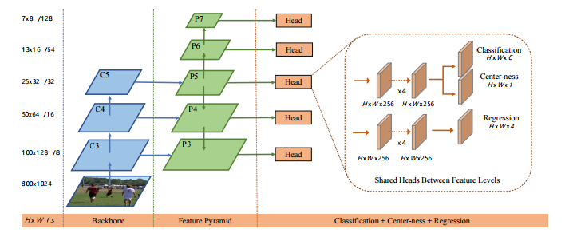

BlendMask - Approach
1. detector module: FCOS
Output: bounding box proposal P

Slide 28
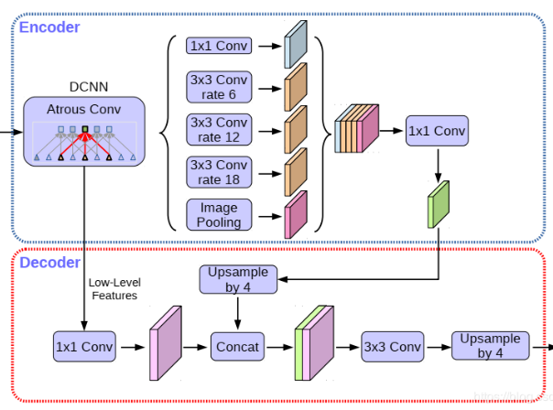


BlendMask - Approach
2. Bottom Module: DeeplabV3+
Input: $H×W$ feature from backbone layer or FPN layer
Output:$N×K×\frac{H}{s}×\frac{W}{s}$ score map B
Capture multi-level context information

Slide 29
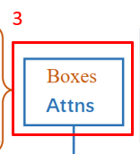

BlendMask - Approach
3. Top layer
Output:$N×(K⋅M⋅M)×H×W$ attentions A
Encode instance-level information, e.g. the coarse shape and pose of the object

Slide 30
BlendMask - Approach
4. Blender Module
1
3
A
P
4
2
B

Slide 31



BlendMask - Approach
4. Blender Module
A ($K⋅M⋅M,H,W)$ :
$a_{d}=RoIAlign(A)$ ($k⋅M⋅M,1,1)$
$a_{d}=reshape\left(a_{0}\right) \left(k,M,M\right)$
$a_{d}^{′}=interpolate_{M×M→R×R}\left(a_{d}\right) \left(K,R,R\right)$
$s_{d}=softmax\left(a_{d}^{′}\right) \left(K,R,R\right)$
B $(K×\frac{H}{s}×\frac{W}{s})$: $\left(K,R,R\right)$
Mask logits $m_{d}$:

Slide 32
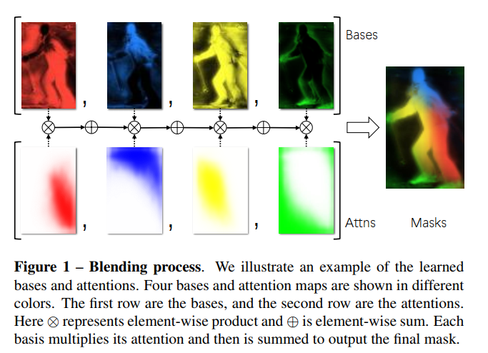
BlendMask - Approach
4. Blender Module: Visualization

Slide 33
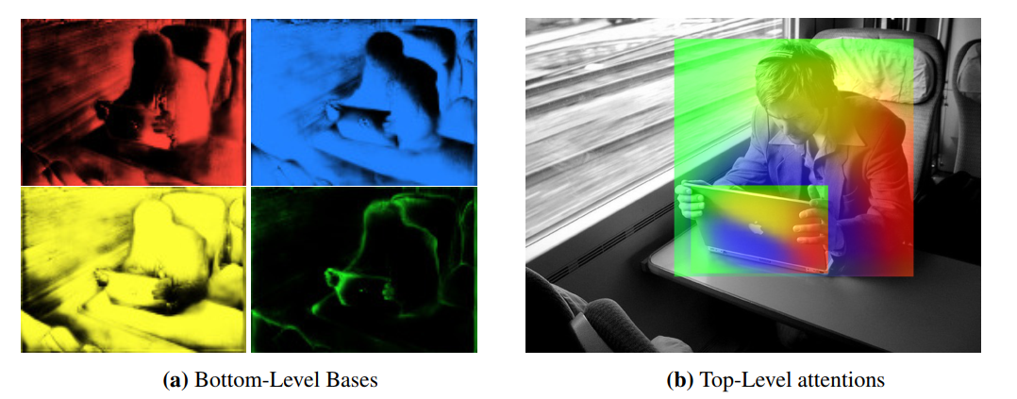
BlendMask - Experiment
Semantics encoded in learned bases and attentions

Slide 34
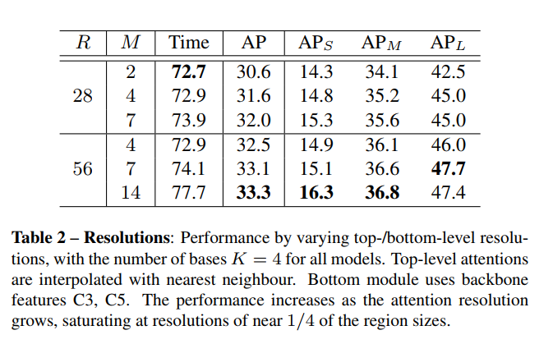
BlendMask - Experiment
Ablation Study
Top and bottom resolutions

Slide 35
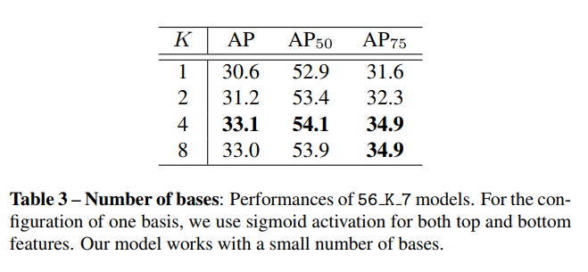
BlendMask - Experiment
Ablation Study
Number of bases

Slide 36
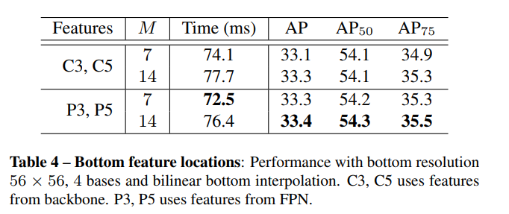
BlendMask - Experiment
Ablation Study
Bottom feature locations: backbone vs. FPN

Slide 37
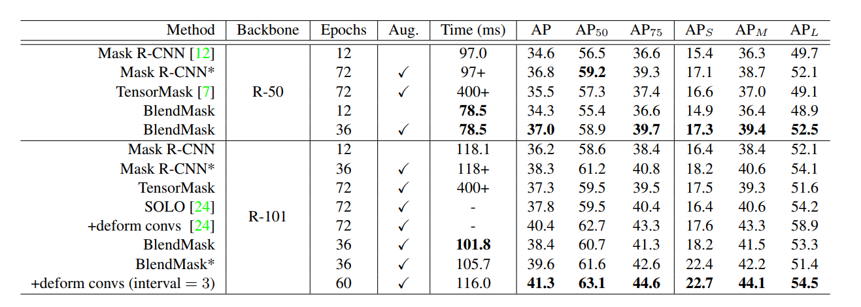
BlendMask - Experiment
Main result on COCO

Slide 38
BlendMask - Conclusion
This model extract the more accurate instance segmentation features through the more reasonable
blender module fusing top-level and low-level semantic information
This model integrates the structure of various excellent algorithms, such as FOCS, Mask R-CNN. Tricky but valuable

Slide 39
Thanks

